Slide 1
FRB Update #31
William Huang

Slide 2
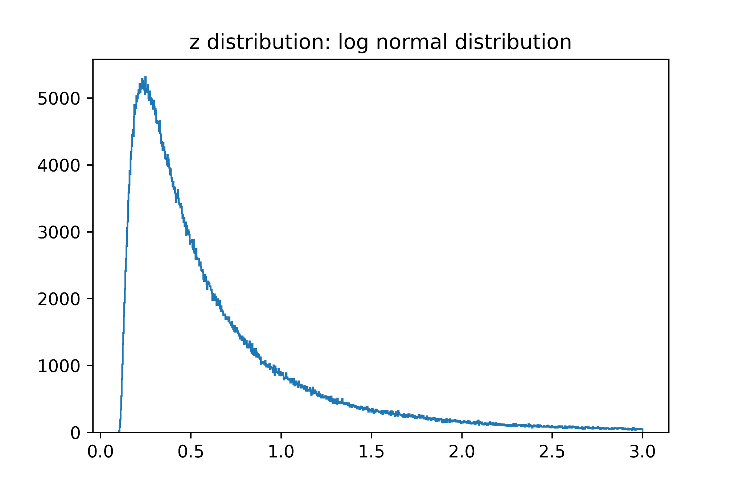
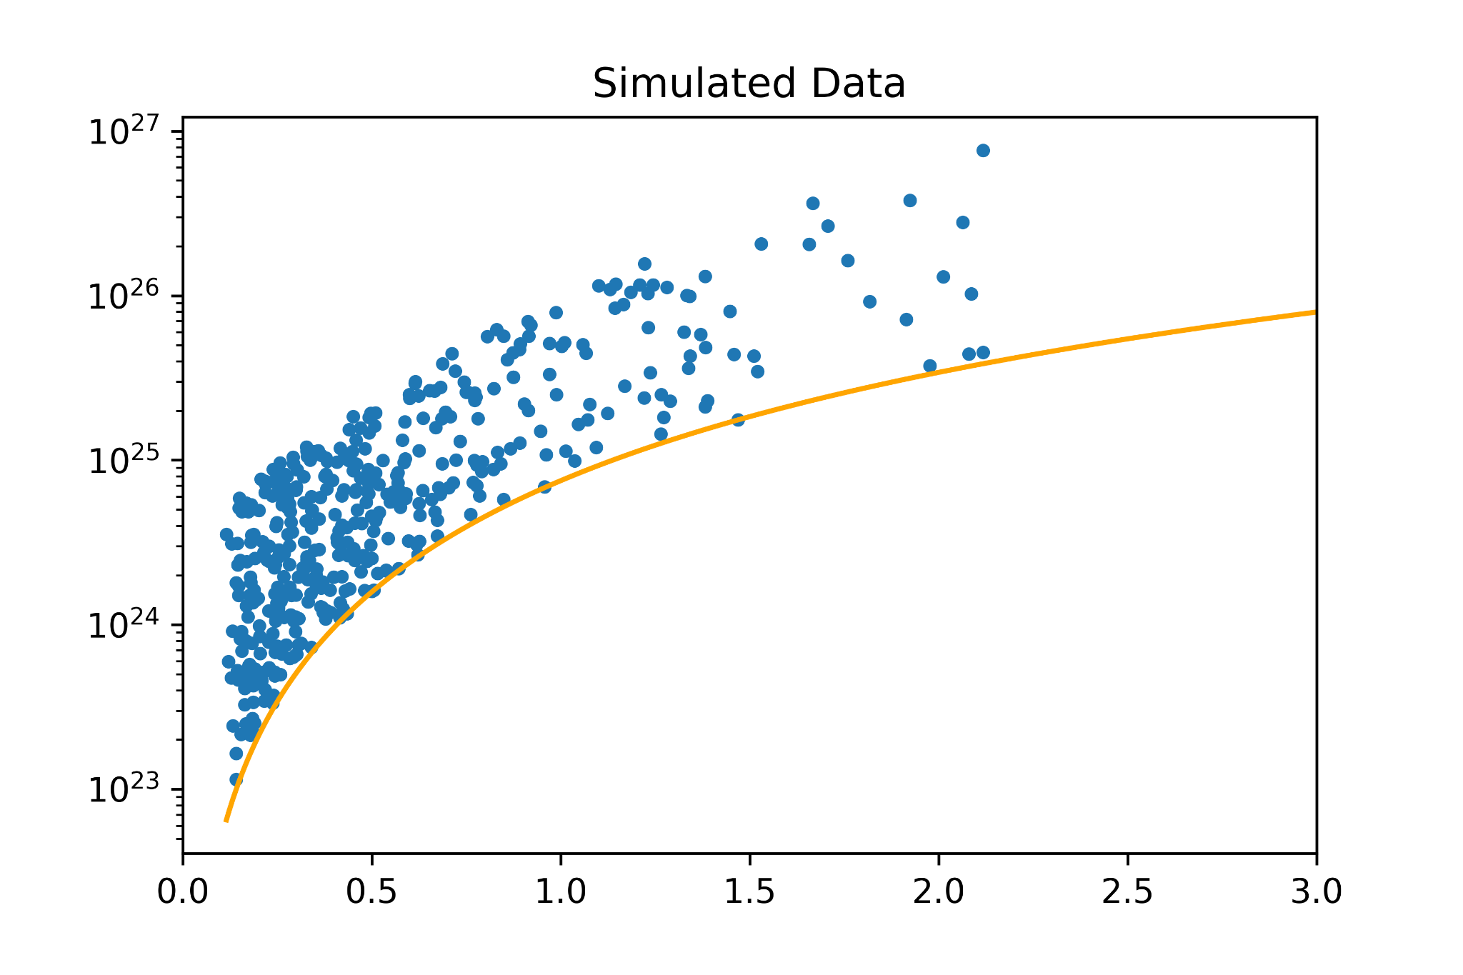
Simulated Data
Log normal distribution
I created simulated data to use in Kendall Tau by first simulating a log-normal distribution in z, up to z=2.2, and an independent uniform distribution in logspace in E. Then, I multiplied each of the E values by (1+z)^{k} depending on the necessary k value.
An example for k = 5 is shown on the right.
Example simulated data

Slide 3
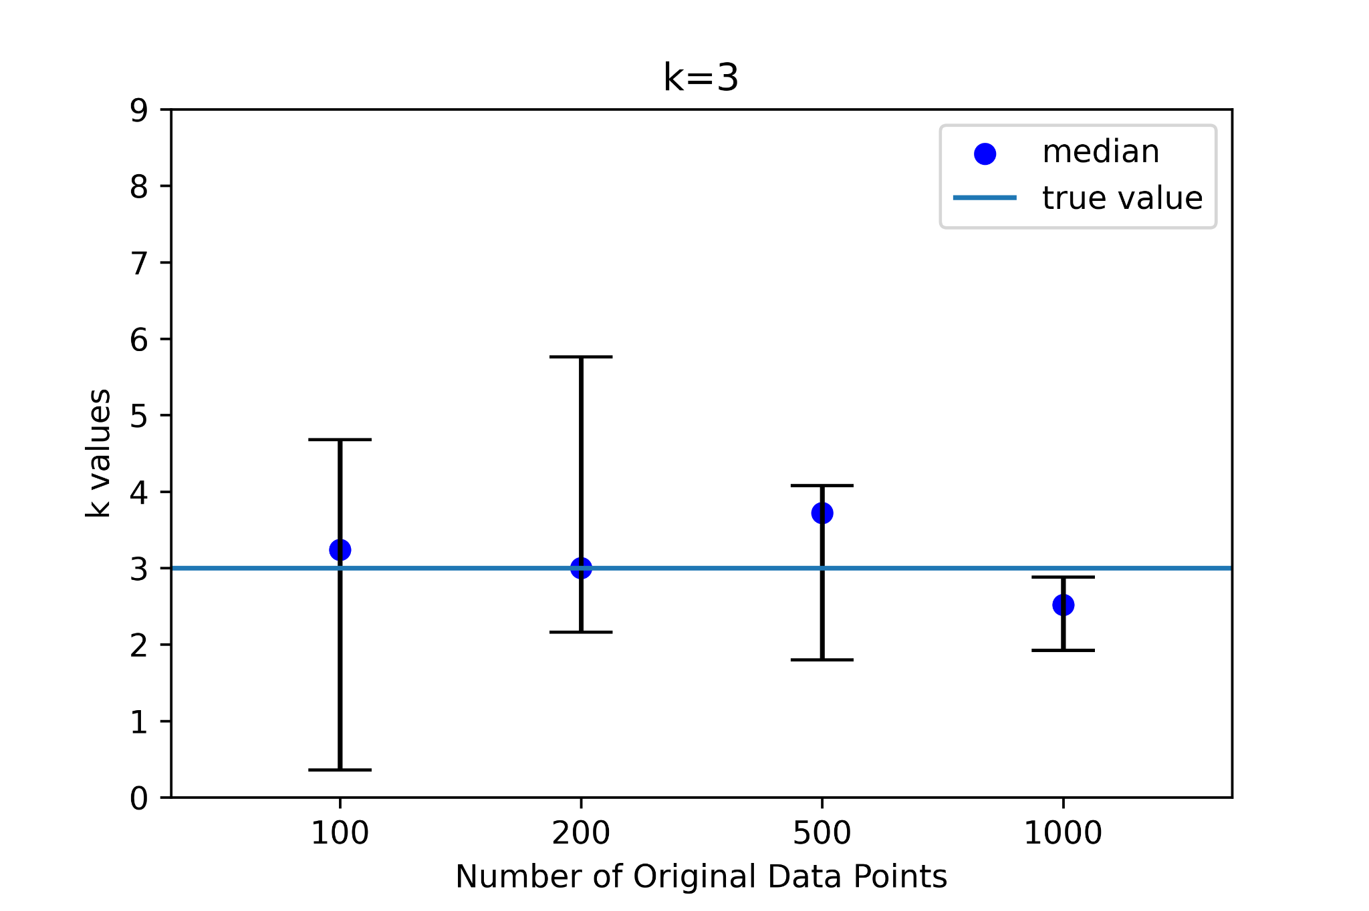
Testing Kendall Tau
I then tested the validity of kendall tau at each k value using a set of 20 simulations, 5 random samples of each of 100, 200, 500, and 1000 data points.* On the right, the results are plotted, with black caps representing the range of k values obtained in the 5 samples, and the blue dot representing the median.
The example for k=3 is plotted on the right.
*Note that each of the numbers denotes the number of points before excluding points below the fluence cutoff. Thus, the actual number of data points above the cutoff is slightly different with each random sample.

Slide 4
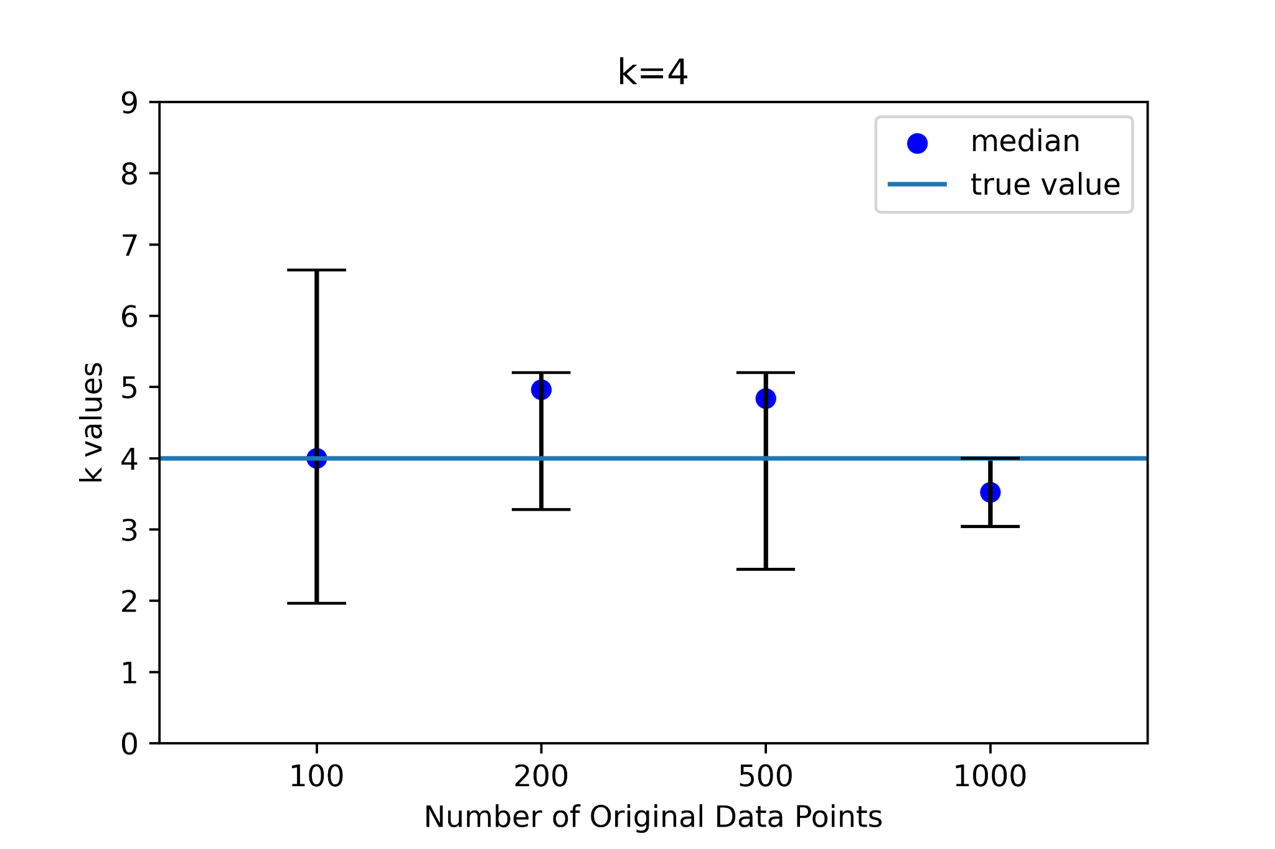
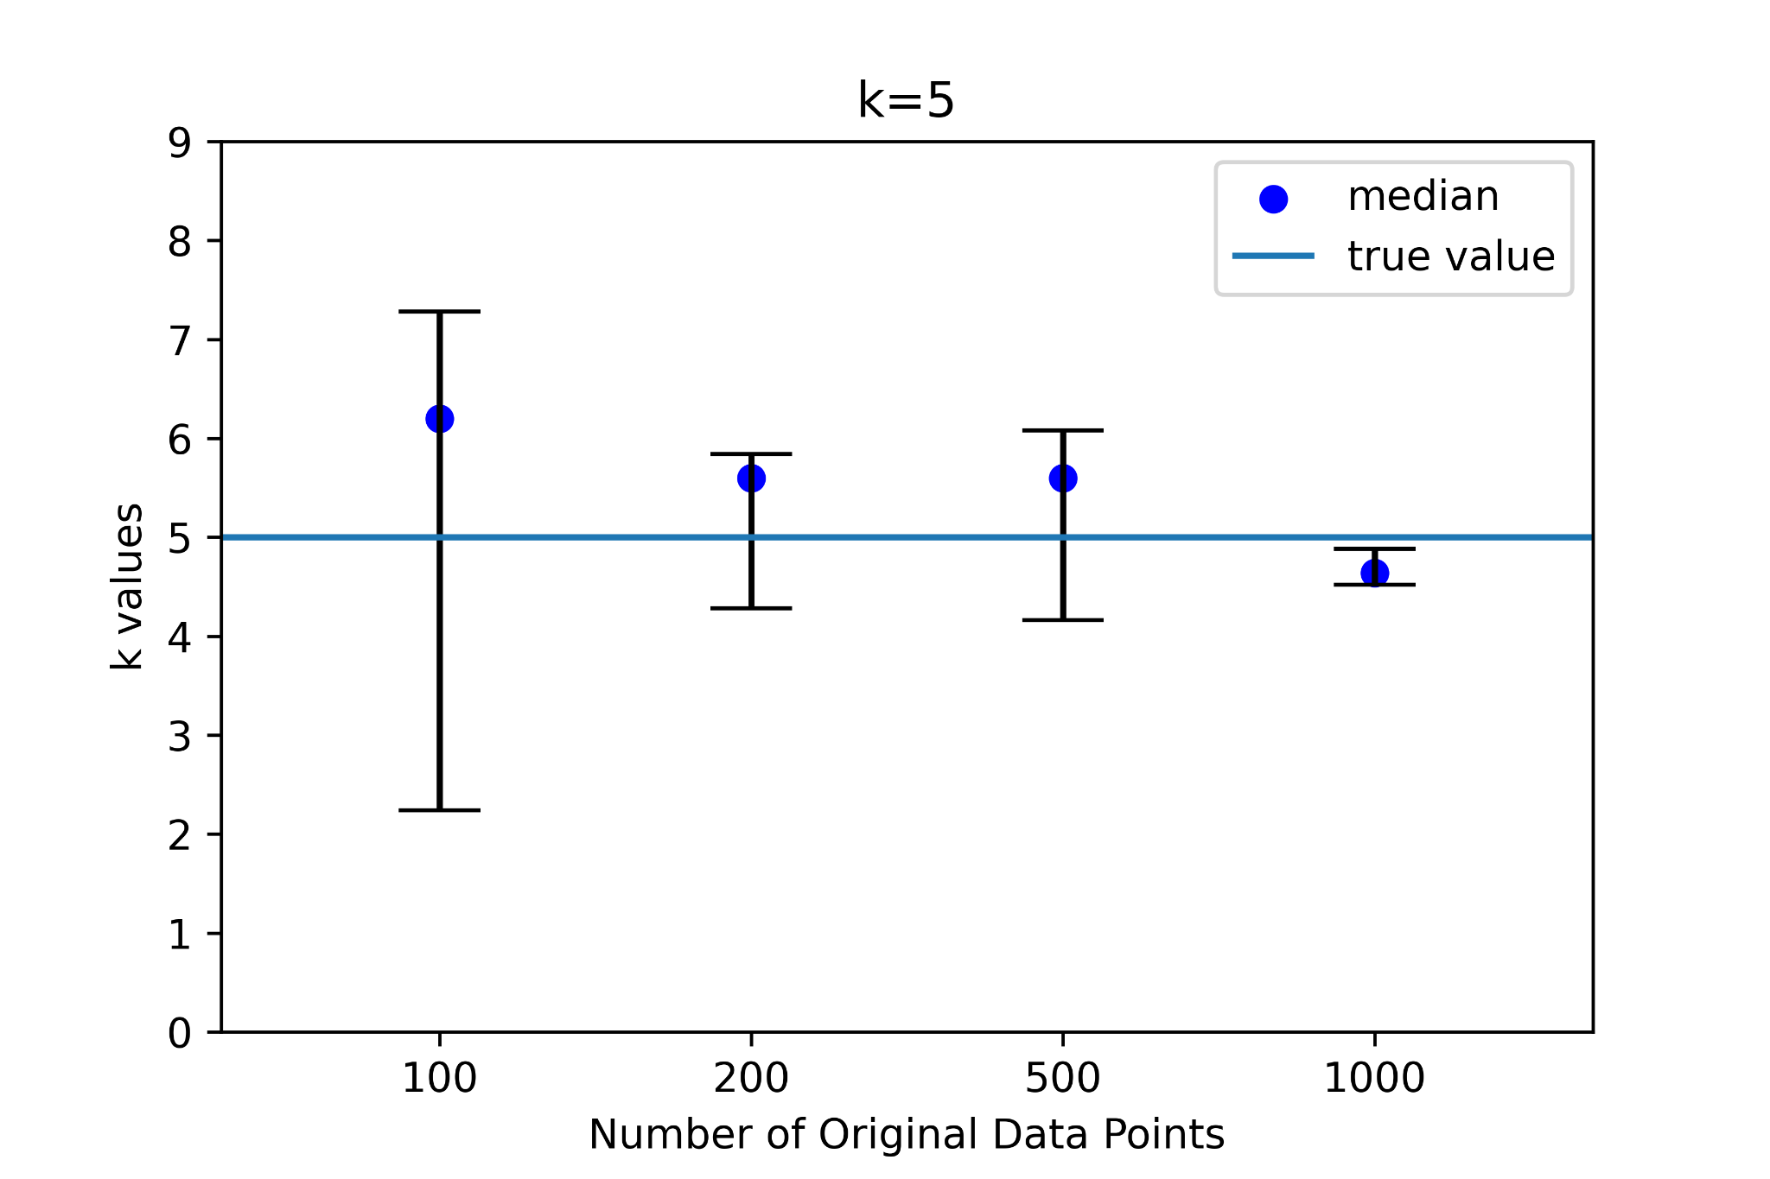
Testing Kendall Tau (cont.)
The graphs for k=4 and k=5 are shown.

Slide 5
Testing Kendall Tau (cont.)
A couple trends are visible from the kendall tau graphs.
In almost all cases, the range of k values includes the correct k value
More data points generally results in more precise k values
A significant number of data points (1000 in this case) is required for a sufficiently precise result
Note that the number of points above the cutoff is ~500

Slide 6
Analysis
It seems that our kendall tau method works with no visible error.
It is also possible that the value of k we obtained for our sample, k~6.3, is simply on the high side of the error range. Our FRB sample of around 360 FRBs above the cutoff corresponds most closely to roughly 500 original data points. At k=5, kendall tau could realistically return around 5 ± 1.5. Compare this to our FRB sample, which returns k=6.3 but has a naive k of around k=5.77. This means that the true value of k could be below the naive value, while the kendall tau returned a higher value.

Slide 7
Further Steps
I will continue to work on implementing
Analysis of Kendall Tau on the old Parkes and ASKAP data.
The more complex function of g(z)
For #2, the complex function of g(z) results in a k value that is even larger, of around k~9. Is this a realistic value of k for FRBs?

